Slide 1
Spanish I and III CLASSES
Course Overview
100% immersion in the target language
Practice speaking in the circle
Practice writing, reading, and listening at desks
Student Expectations
Be Active Participants
Give an honest effort when participating
Be open to mistakes because you learn from your mistakes
It is NOT ok to quit, refuse to try or discourage others from trying

Slide 2
GRADING
Modes of Communication
Interpretive Reading-one-way communication – 18%
Interpretive Listening -one-way communication – 18%
Presentational Writing -one-way communication – 18%
Presentational (one-way communication) and Interpersonal Communication (two-way communication) Speaking – 20%
Practice & classwork– 6%
Final – 20%: Reading (5%), Listening (5%), Writing (5%), & Speaking (5%)
STUDENTS CAN REDO ANY ASSESSMENT BUT MOST COME TO TUTORING AFTTER SCHOOL OR DURING PRIDE PERIOD!!!

Slide 3
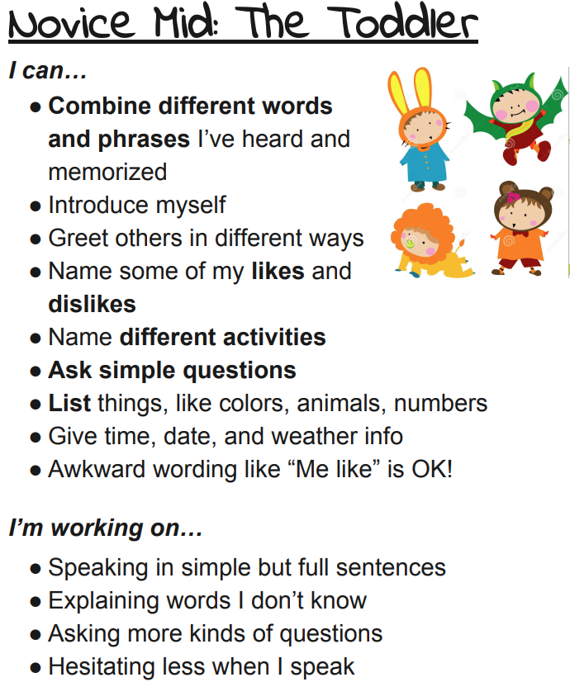
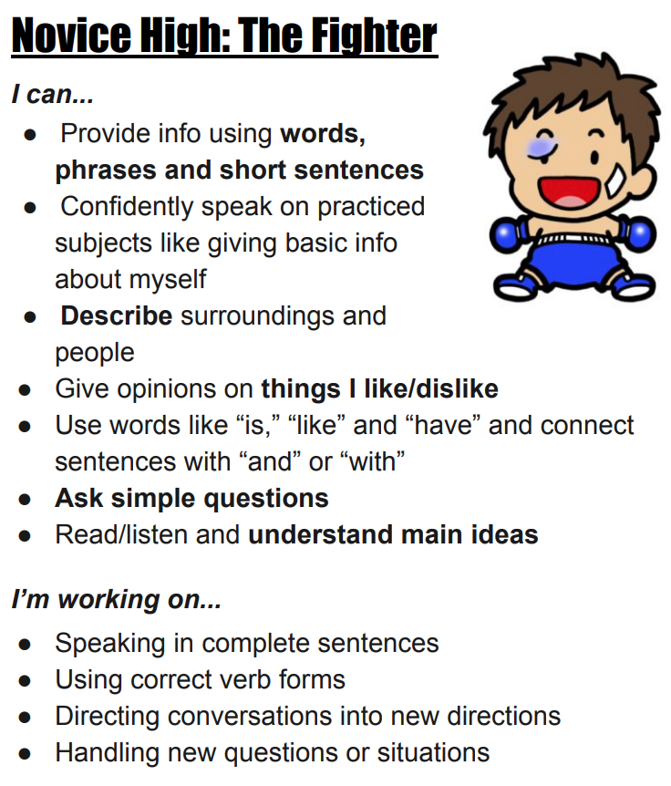
Novice LOW/MID/HIGH

Slide 4
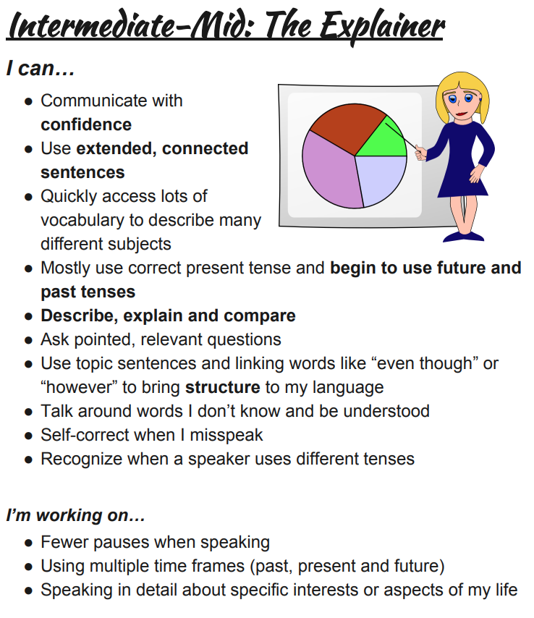
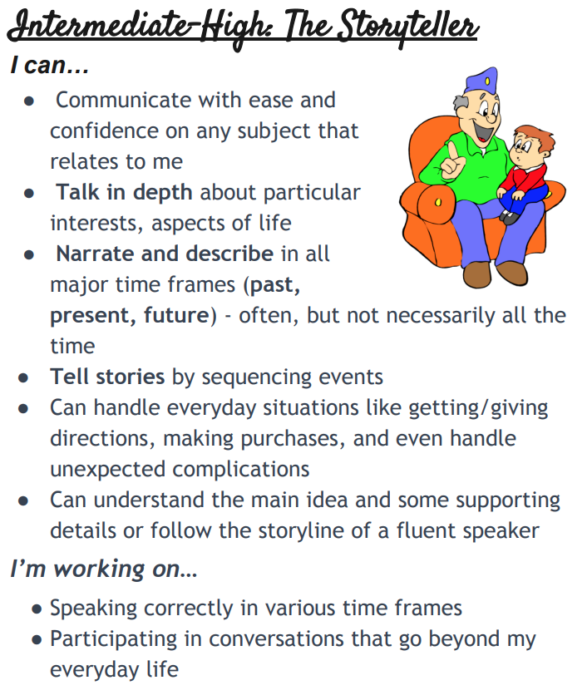
Intermediate LOW/MID/HIGH

Slide 5
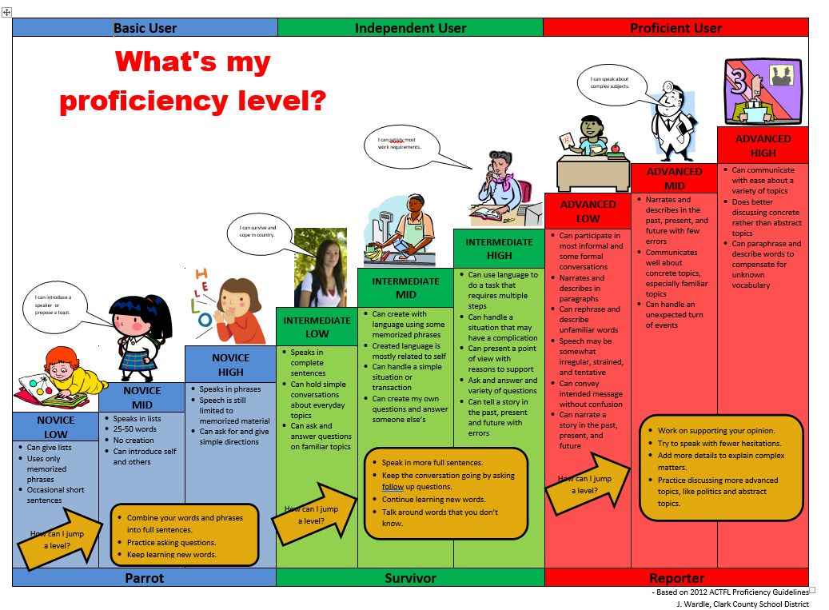

Slide 6
GRADING
The following metrics will be used for all modes of communication:
4: Exceeds expectations
Student has demonstrated mastery of the standards/learning target and exceeded the expected level of performance. Student is using the learning in novel ways.
3: Meets expectations
Student has demonstrated mastery of the standards/learning target and met the expected level of performance.
2: Approaching expectations
Student has demonstrated some mastery of the standards/learning target but has some work to do to meet the expected level of performance.
1: Not enough evidence that student has met expectations
Student has demonstrated only partial/minimal mastery of standards/learning targets.
0: No evidence has been provided

Slide 7
1 = Novice Low & Novice Mid 2 = Novice High and Inter. 1 3 = Intermediate 2 4 = Intermediate 3 & 4

Slide 8
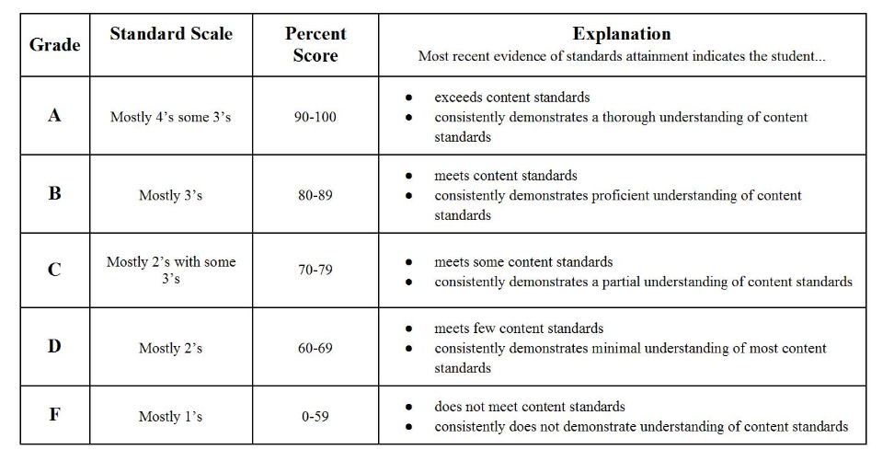
GRADING

Slide 9
CONTACT INFORMATION
EMAIL – mlynn@Murrieta.k12.ca.us
PHONE - (951) 677-0568 ext.6251
Webiste for syllabus https://www.murrieta.k12.ca.us/Domain/2182

